Slide 1
CHAPTER - 4
Digital Transmission
Part-2

Slide 2
Bipolar Schemes
In bipolar encoding (sometimes called multilevel binary), there are three voltage levels: positive, negative, and zero. The voltage level for one data element is at zero, while the voltage level for the other element alternates between positive and negative.
There are two variations of bipolar encoding:
    (1). AMI (Alternate Mark Inversion )
    (2). Pseudoternary.

Slide 3

Cont.
Alternate Mark Inversion (AMI):
  In the term alternate mark inversion, the word mark comes from telegraphy and means 1.
  So AMI means alternate 1 inversion.
  A neutral zero voltage represents binary 0.
  Binary 1s are represented by alternating positive and negative voltages.

Slide 4
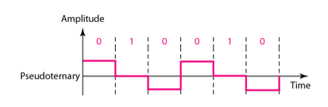
Cont.
Pseudoternary:
  A variation of AMI encoding is called pseudoternary in which
  1 bit is encoded as a zero voltage.
  0 bit is encoded as alternating positive and negative voltages.

Slide 5
Multilevel Scheme
The desire to increase the data speed or decrease the required bandwidth has resulted in the creation of many schemes. The goal is to increase the number of bits per baud by encoding a pattern of m data elements into a pattern of n signal elements. We only have two types of data elements (0s and 1s), which means that a group of m data elements can produce a combination of 2^{m} data patterns. We can have different types of signal elements by allowing different signal levels. If we have L different levels, then we can produce L^{n} combinations of signal patterns.

Slide 6
Cont.
The code designers have classified these types of coding as mBnL.
Where
  m is the length of the binary pattern,
  B means binary data,
  n is the length of the signal pattern, and
  L is the number of levels in the signaling.
      A letter is often used in place of L: B (binary) for L =2, T (ternary) for L =3, and Q (quaternary) for L =4.
Note that the first two letters define the data pattern, and the second two define the signal pattern.

Slide 7
2B1Q
The first mBnL scheme we discuss, two binary, one quaternary (2B1Q), uses data patterns of size 2 and encodes the 2-bit patterns as one signal element belonging to a four-level signal.
In this type of encoding m =2, n =1, and L =4 (quaternary). Figure 4.10 shows an example of a 2B1Q signal.

Slide 8
2B1Q
n= Length of the signal pattern
m=Length of the binary pattern
m B n L
B=Binary data
L= Number of levels in signaling
B (Binary), L=2
T (Ternary), L=3
Q (Quaternary), L=4

Slide 9
Cont.
Number of data pattern = 2^{m}
= 2²
=4
Number of signal pattern= L^{n}
= 4¹
=4

Slide 10

Cont.
 | Previous level Positive | Previous level Negative
Next Bit | Next Level | Next Level
00 | +1 | -1
01 | +3 | -3
10 | -1 | +1
11 | -3 | +3

Slide 11
8B6T
A very interesting scheme is eight binary, six ternary (8B6T).
The idea is to encode a pattern of 8 bits as a pattern of 6 signal elements, where the signal has three levels (ternary).
In this type of scheme, we can have 2⁸=256 different data patterns and 3⁶ =729 different signal patterns.
The mapping table is shown in Appendix D.
There are 729 - 256 =473 redundant signal elements that provide synchronization and error detection.

Slide 12
Cont.
Part of the redundancy is also used to provide DC balance.
Each signal pattern has a weight of 0 or +1 DC values. This means that there is no pattern with the weight -1.
To make the whole stream Dc-balanced, the sender keeps track of the weight.
If two groups of weight 1 are encountered one after another, the first one is sent as is, while the next one is totally inverted to give a weight of -1.

Slide 13
Cont.
Figure 4.11 shows an example of three data patterns encoded as three signal patterns. The three possible signal levels are represented as -,0, and +. The first 8-bit pattern 00010001 is encoded as the signal pattern -0-0++ with weight 0; the second 8-bit pattern 010 10011 is encoded as - + - + + 0 with weight +1. The third bit pattern should be encoded as + - - + 0 + with weight +1. To create DC balance, the sender inverts the actual signal. The receiver can easily recognize that this is an inverted pattern because the weight is -1. The pattern is inverted before decoding.

Slide 14
8B6T
n= Length of the signal pattern
m=Length of the binary pattern
m B n L
B=Binary data
L= Number of levels in signaling
B (Binary), L=2
T (Ternary), L=3
Q (Quaternary), L=4

Slide 15
Cont.
Number of data pattern = 2^{m}
= 2⁸
=256
Number of signal pattern = L^{n}
= 3⁶
=729
There are 729 - 256 =473 redundant signal elements that provide synchronization and error detection. Part of the redundancy is also used to provide DC balance.
DC balance of 8B6T:
- 0 – 0 + + = Weight: 0
- - + + 0 + = Weight: +1

Slide 16
Cont.
Mapping Table 8B6T (Partial) (Appendix D)
Data | Code | Data | Code
00 | - + 0 0 - + | 2A | + 0 + - 0 -
11 | - 0 - 0 + + | 50 | + - - + 0 +
0A | 0 - + + - 0 | 53 | - + - + + 0

Slide 17

Cont.
Data | Code | Weight | Invert | Weight
0001 0001 (11) | - 0 - 0 + + | 0 |  | 0
0101 0011 (53) | - + - + + 0 | +1 |  | +1
0101 0000 (50) | + - - + 0 + | +1 | - + + - 0 - | -1
Total weight |  |  |  | 0

Slide 18
Multiline Transmission: MLT-3
NRZ-I and differential Manchester are classified as differential encoding but use two transition rules to encode binary data (no inversion, inversion).
If we have a signal with more than two levels, we can design a differential encoding scheme with more than two transition rules. MLT-3 is one of them.

Slide 19
Cont.
The multiline transmission, three level (MLT-3) scheme uses three levels (+v, 0, and - V) and three transition rules to move between the levels.
  (1). If the next bit is 0, there is no transition.
  (2). If the next bit is 1 and the current level is not 0, the next level is 0.
  (3). If the next bit is 1 and the current level is 0, the next level is the opposite of the last nonzero level.

Slide 20

Cont.
Let us assume that, the last level was at 0 voltage and the last non-zero pulse was negative.

Slide 21
Summary of Line Coding Schemes
Category | Scheme | Bandwidth (Average) | Characteristics
Unipolar | NRZ | B=N/2 | Costly, no self-synchronization if long 0s or 1s, DC
Polar | NRZ-L | B=N/2 | No self-synchronization if long 0s or Is, DC
 | NRZ-I | B=N/2 | No self-synchronization for long aS, DC
 | Biphase | B=N | Self-synchronization, no DC, high bandwidth
Bipolar | AMI | B=NI2 | No self-synchronization for long OS, DC
Multilevel | 2B1Q | B=N/4 | No self-synchronization for long same double bits
 | 8B6T | B =3N/4 | Self-synchronization, no DC
 | 4D-PAM5 | B=N/8 | Self-synchronization, no DC
Multiline | MLT-3 | B=N/3 | No self-synchronization for long Os

Slide 22
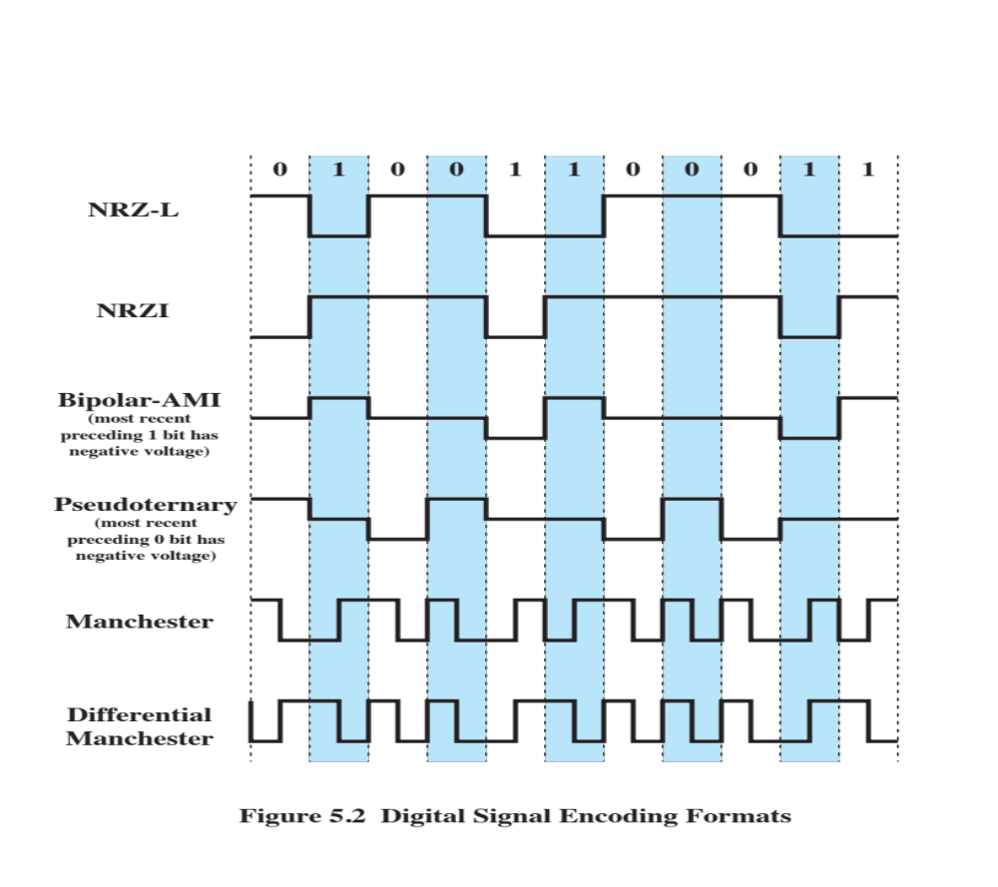
semester

Slide 23
Real life Application of
Digital-to-Digital conversion
H.W

